Slide 1
Packing and Processing unit
APIS Divine Honey

Slide 2


Slide 3
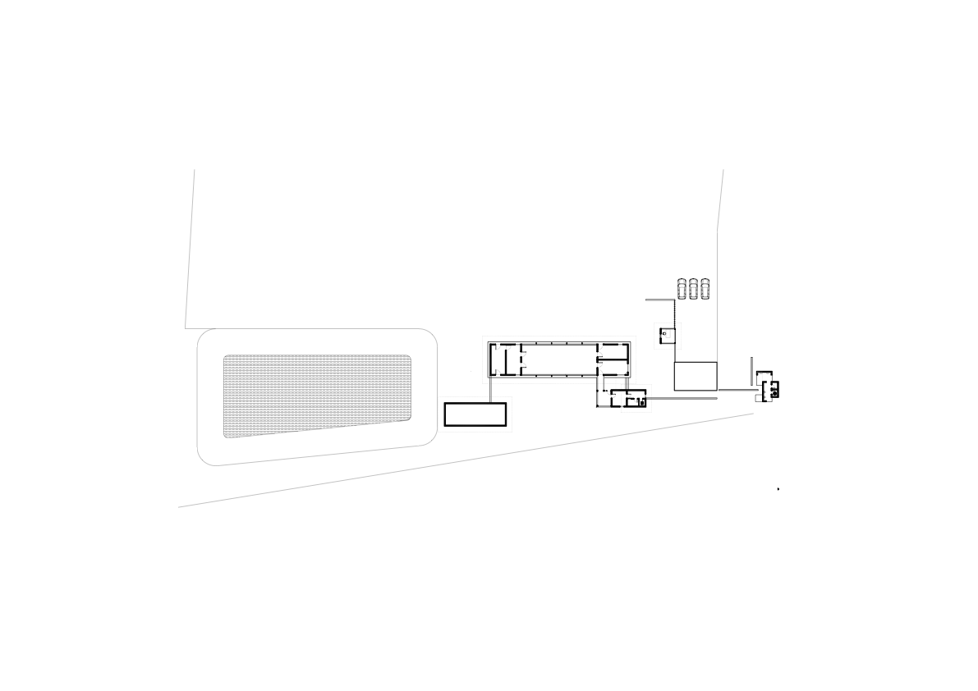

Slide 4


Slide 5


Slide 6
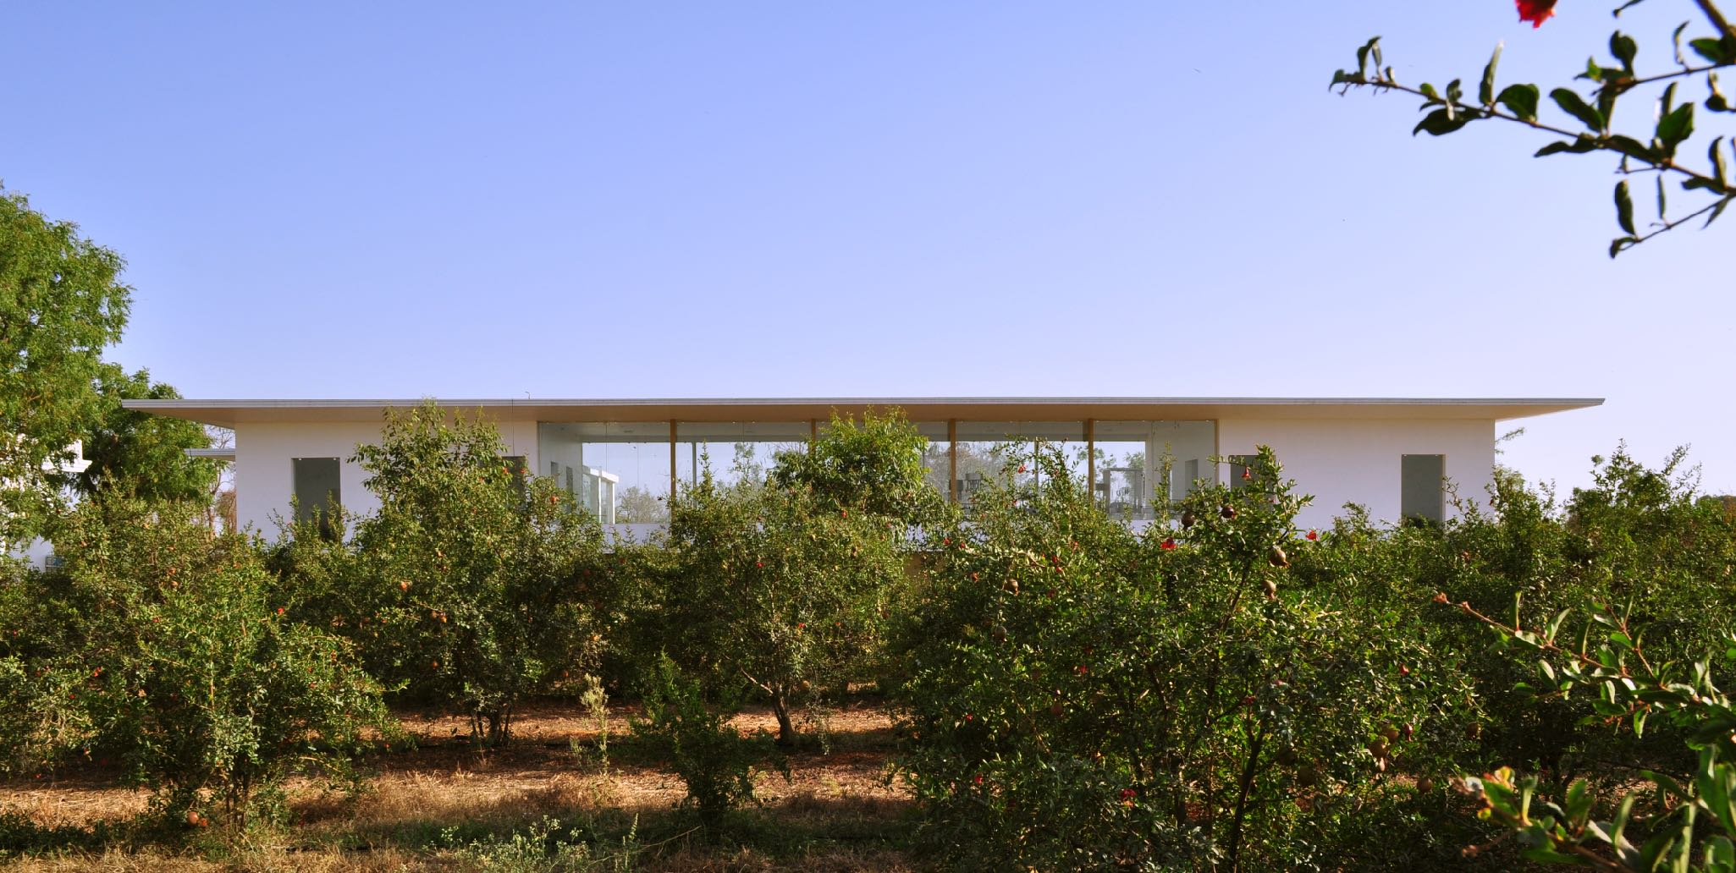

Slide 7


Slide 8
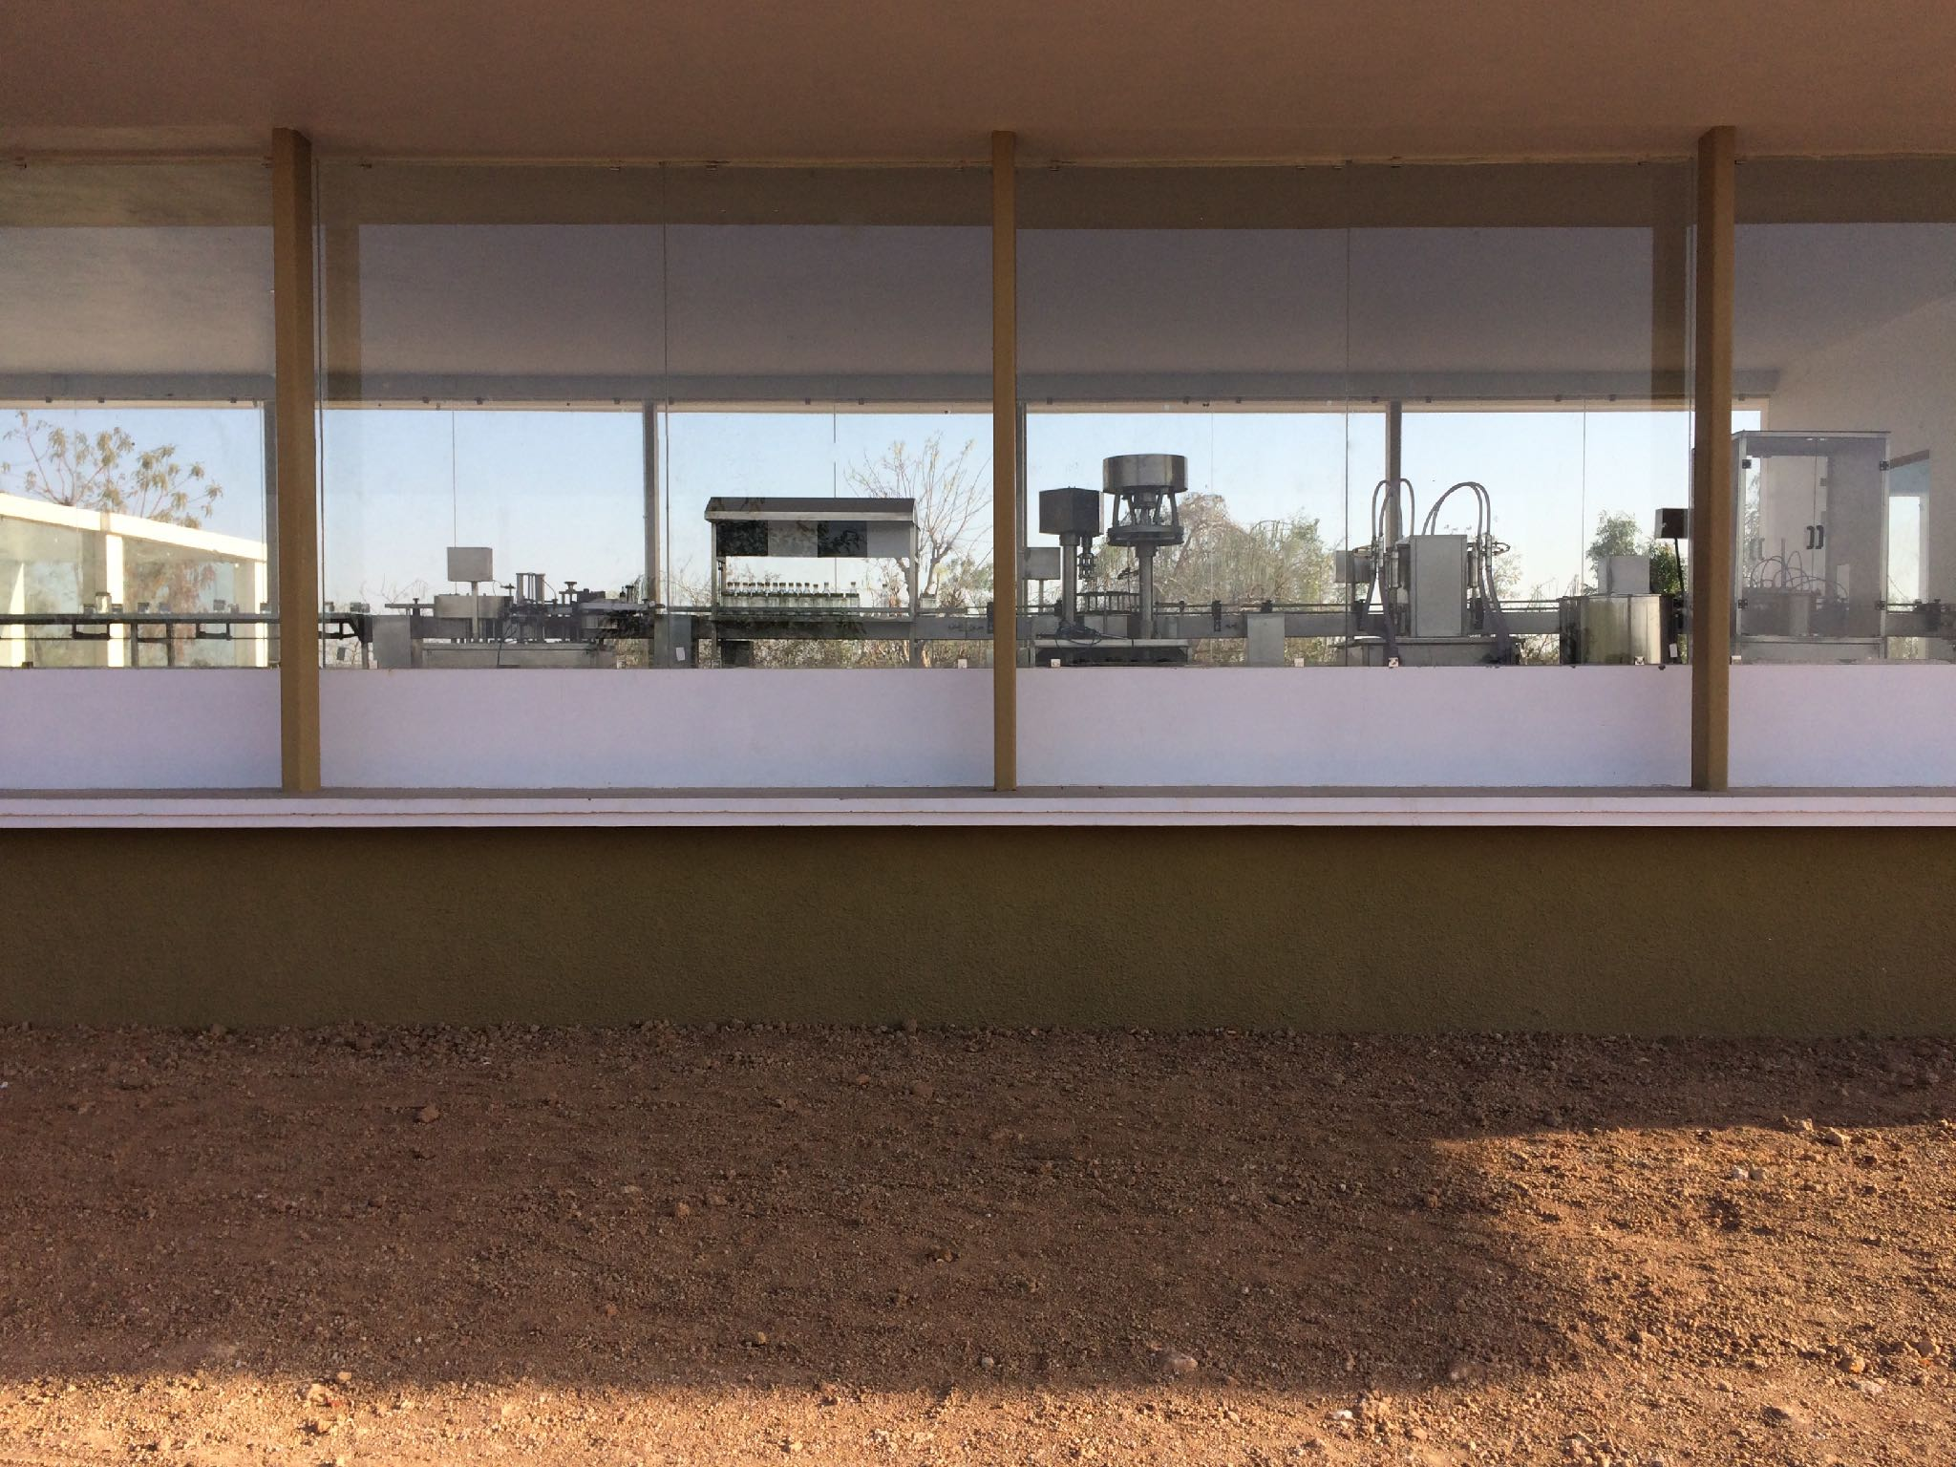

Slide 9


